Slide 1
SOFTWARE ENGINEERING
ASSIGNMENT
SUBMITTED BY -
DIVYANSH JOSHI
KANKANA MAJUMDER
BHANU PRATAP SINGH
SUBMITTED TO -
Dr. ARUNA M
10th June,2022

Slide 2
OBJECT RECOGNITION MODEL

Slide 3
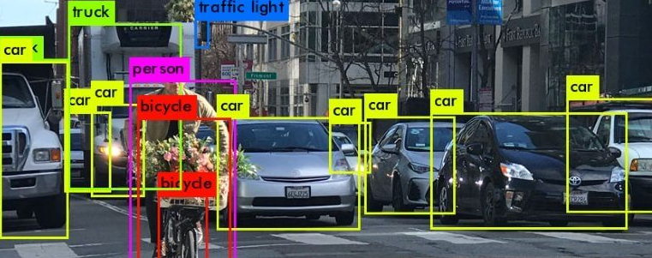
WHAT IS OBJECT RECOGNITION ?
Object recognition is a key output of deep learning and machine learning algorithms. When humans look at a photograph or watch a video, we can readily spot people, objects, scenes, and visual details, Similarly we are teaching or computer to do the same by deep learning.

Slide 4
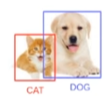
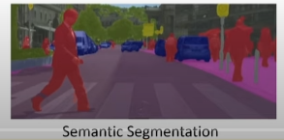
BRAINSTORMING
Finding the salient feature of the image and classifying the image.
We will be using a combination of algorithm.
SSD (single shot detection) - for finding most prominent feature
MobileNetv3 - for classifying the salient feature
For better visualization segmentation dataset is also used CityScape.

Slide 5
BRAINSTORMING
Currently we are using pre trained deep learning architecture based on tensorflow model.
For implementation we will be using OPENCV to load pre trained tensorflow model
Dataset we will be using COCO dataset(large-scale object detection, segmentation, and captioning dataset.)

Slide 6

REQUIREMENT
We need python 3 as our programing language.
Anaconda application for installing libraries like OPENCV etc.
IDEs are required
Jupyter notebook
Spyder
VSCode

Slide 7
Project Plan
We are making this object recognition model with the scope of detecting object on so as to
prevent theft and faults
To achieve this we are using the following:
Finding the salient feature of the image and classifying the image.
We will be using a combination of algorithms.
SSD (single shot detection) - for finding most prominent feature
MobileNetv3 - for classifying the salient feature
For better visualization segmentation dataset is also used CityScape.

Slide 8
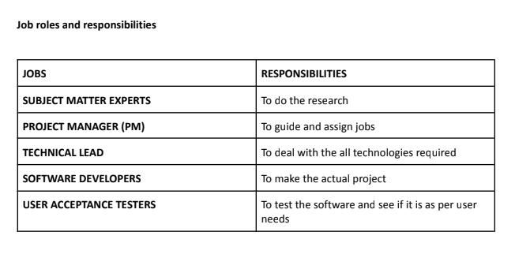
Project Management Plan

Slide 9
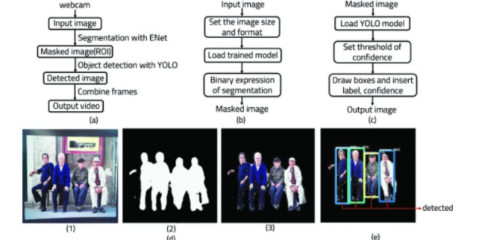
System Architecture

Slide 10
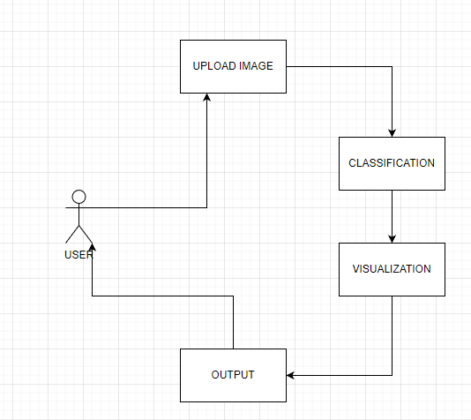
USE CASE DIAGRAM

Slide 11
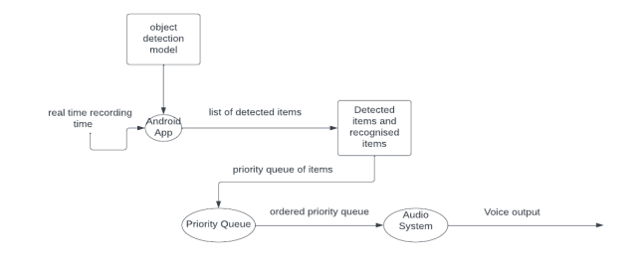
Data Flow Diagram

Slide 12
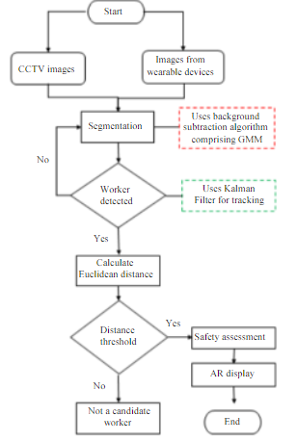
Entity Relationship
.

Slide 13
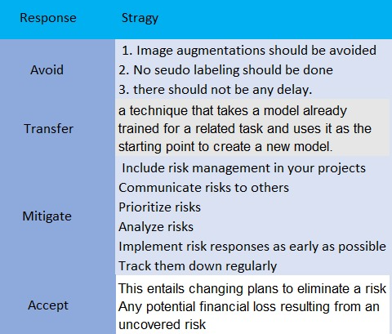
Risk Management

Slide 14
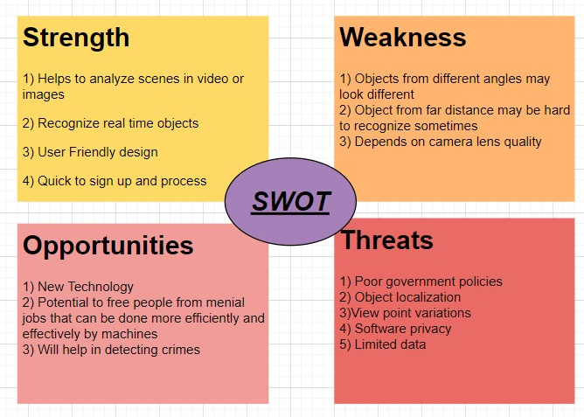
Risk Management

Slide 15
THAT'S ALL FOR NOW!!
THANK YOU!!!!!

